Slide 1

Bank loan Database Analytics
by Saifuddin sanusi

Slide 2
Agenda
Objectives
Data Analysis
Project Limitations
Recommendations

Slide 3
OBJECTIVES
Track Loan Applications: Measure the total number of loan applications, including Month-to-Date (MTD) and Month-over-Month (MoM) changes, to gain insight into the trends and demands of loan applicants.
Monitor Disbursed Loans: Calculate and track the total amount of loans funded during a specific period, including MTD funded loans and MoM changes, to understand lending volumes and variations over time.
Assess Loan Repayment: Track the total amount received from borrowers and analyze MTD and MoM changes to evaluate the bank's cash flow and repayment patterns.

Slide 4


OBJECTIVES
Analyze Financial Health: Calculate the average interest rate and Debt-to-Income (DTI) ratio across all loans, providing a comprehensive look at the cost of lending and the financial stability of borrowers.
Visualize Lending Patterns: Provide detailed data visualizations, including monthly trends, regional analysis, loan term distributions, and borrower demographics, allowing for better insights into loan activity across different dimensions.
Support Decision-Making: Enable stakeholders to make data-informed decisions by identifying lending trends, understanding borrower behavior, and recognizing regional disparities in loan applications and funding.

Slide 5
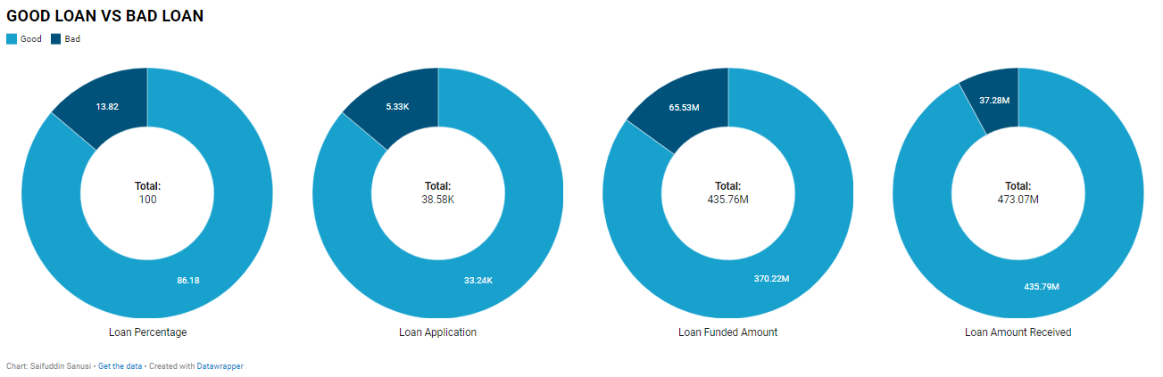
GOOD LOAN VS BAD LOAN
Loan Distribution:
Good Loans account for 86.18% of the total loans, with 33,243 applications.
Bad Loans make up 13.82%, with 5,333 applications.
This indicates that a significant majority of the bank's loan portfolio consists of good loans, showing a healthy lending performance.

Slide 6
Overview (GOOD LOAN VS BAD LOAN)
Funded Amount:
The total funded amount for Good Loans is approximately 370.22 million, while for Bad Loans it is 65.53 million.
Good Loans dominate in terms of loan funding, as nearly 85% of the total loan funds are allocated to good loans.
Recommendation:
Improve Risk Assessment for Bad Loans: Investigate the characteristics of the 5,333 bad loan applications and develop more stringent risk assessment criteria. By understanding the common traits or risk factors, the bank can fine-tune its screening process to reduce the number of bad loans.
Focus on Loan Recovery for Bad Loans: While bad loans account for 13.82% of total loans, their impact on funds received is significant, with only 37.28 million recovered compared to 65.53 million funded. Strengthening loan recovery efforts (e.g., restructuring, legal action, or incentives for repayment) could improve the recovery rate.

Slide 7
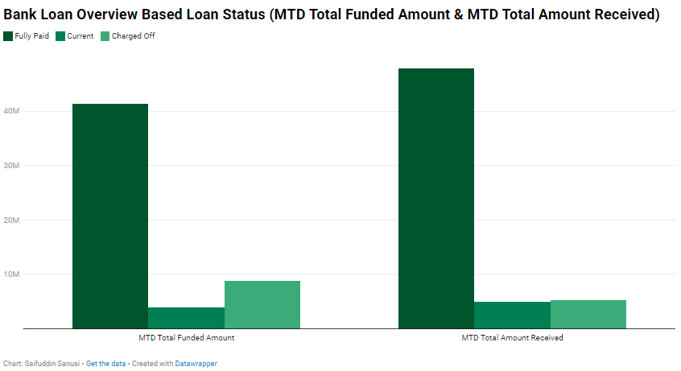
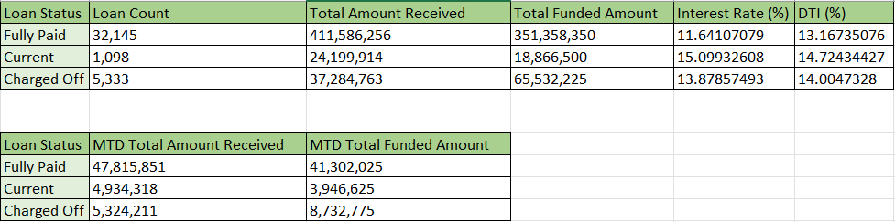
Overview (Loan Status)
Fully Paid Loans account for 32,145 out of the total loans, contributing a total funded amount of 351.36 million and generating 411.59 million in repayments. These loans have an average interest rate of 11.64% and an average Debt-to-Income (DTI) ratio of 13.17%.
Current Loans represent 1,098 loans, with 24.20 million received and 18.87 million funded. These loans have a relatively higher average interest rate of 15.10% and a DTI of 14.72%, indicating that these are still in repayment and might present a higher risk due to the higher DTI and interest rate.
Charged-Off Loans consist of 5,333 loans that have been written off as defaults, with 37.28 million received versus 65.53 million funded. The average interest rate is 13.88%, and the DTI ratio is 14.00%, reflecting riskier borrowers.

Slide 8
Overview (Loan Status)
Month-to-Date (MTD) Performance:
Fully Paid Loans, the Month-to-Date (MTD) total amount received is 47.82 million, with a corresponding funded amount of 41.30 million, indicating a strong repayment performance.
Current Loans show an MTD total amount received of 4.93 million and an MTD funded amount of 3.95 million. The relatively high receipts compared to funded amounts indicate borrowers are actively paying off their balances.
Charged-Off Loans have an MTD total received of 5.32 million against an MTD funded amount of 8.73 million, indicating some level of recovery despite their default status.
Interest Rate and DTI Insights:
Fully paid loans have the lowest average interest rate at 11.64% and DTI at 13.17%, indicating that borrowers with lower interest rates and DTI ratios are more likely to successfully repay loans.
Current loans have the highest interest rate at 15.10% and a DTI of 14.72%, suggesting these are higher-risk loans that may still perform well.
Charged-Off loans feature a higher average interest rate of 13.88% and a DTI ratio of 14.00%, confirming that loans with higher interest rates and DTI ratios are more likely to default.

Slide 9
Overview (Loan Status)
Conclusion
The bank’s loan portfolio is performing well overall, with fully paid loans showing strong repayment trends and relatively low-risk metrics (low interest rate and DTI). However, charged-off loans represent a significant portion of defaults, and borrowers with higher interest rates and DTI ratios are more prone to default
Future Recommendations
Introduce Tiered Interest Rate Loan Products:
To encourage successful repayments, the bank could offer lower interest rates to borrowers who maintain good repayment behavior - a "reward" system for consistent payers.
Predictive Analytics for Early Warning Systems:
Implement predictive analytics to identify loans at risk of becoming charged-off. By analyzing patterns in borrower behavior (e.g., late payments, high DTI, or increasing loan balances), the bank can intervene earlier with payment plans

Slide 10
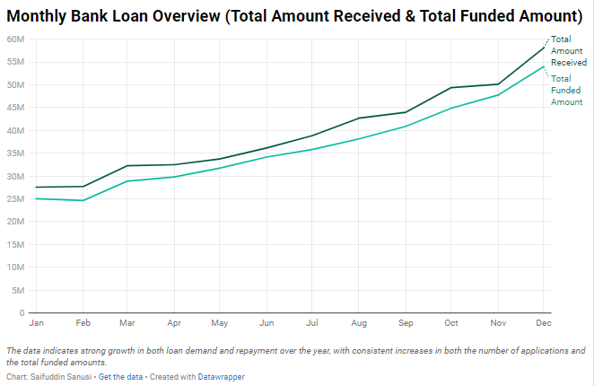
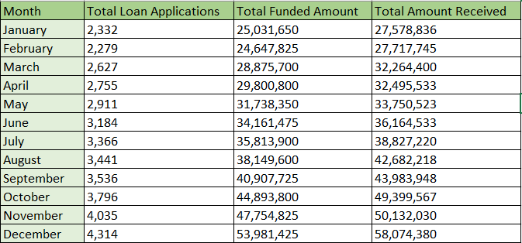
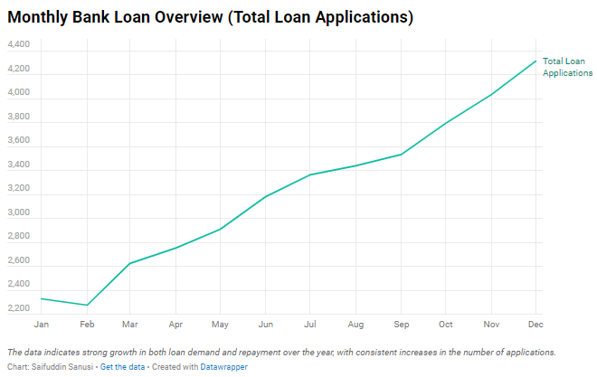
OVERVIEW(Monthly)
Loan Applications:
The number of loan applications increases steadily throughout the year, starting from 2,332 applications in January and peaking at 4,314 applications in December.
Total Funded Amount:
The total funded amount follows a similar upward trend, beginning at $25.03 million in January and reaching $53.98 million in December.
Total Amount Received:
The total amount received by the bank shows consistent growth, with $27.58 million in January and $58.07 million in December.

Slide 11
OVERVIEW(Monthly)
Conclusion
The bank has experienced strong loan growth throughout the year, with significant increases in both the number of applications and the total amount of loans funded. The second half of the year shows particularly robust growth in loan demand and repayment performance, as demonstrated by the sharp increase in both total funded amounts and total amount received.
The steady rise in loan applications and the corresponding increase in funded amounts indicate that the bank has been able to successfully meet borrower demand.
Future Recommendations:
Expand Loan Offerings in High-Demand Months:
The data indicates that demand for loans is highest in the second half of the year, particularly from July to December. The bank should prepare for this by ensuring ample liquidity and potentially rolling out new or promotional loan products during these months to capture even more demand.
Utilize Predictive Analytics for Demand Forecasting:
The clear seasonality in loan applications and funding suggests that the bank could benefit from more precise demand forecasting. By using predictive analytics, the bank can anticipate the number of loan applications it will receive and prepare accordingly (e.g., staffing, liquidity management).

Slide 12
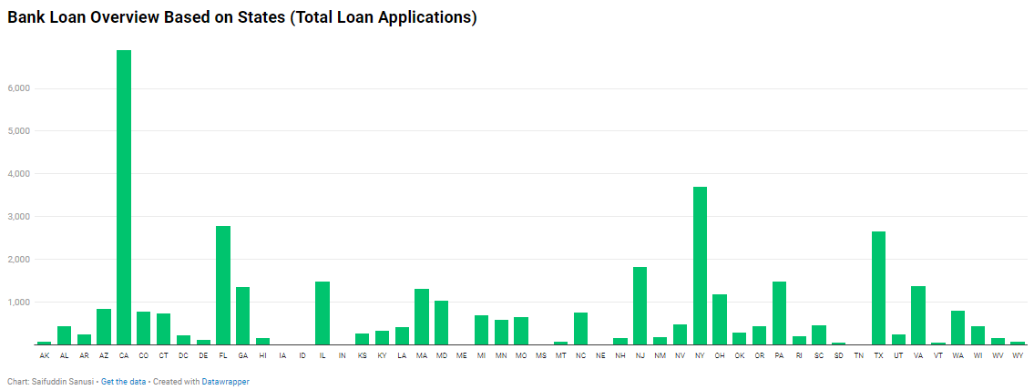
Overview (states)
State-wise Loan Applications:
California (CA) leads with 6,894 total loan applications, followed by New York (NY) with 3,701 applications and Florida (FL) with 2,773 applications.
States with very low loan application counts include Iowa (IA) and Nebraska (NE), each having fewer than 10 applications.

Slide 13
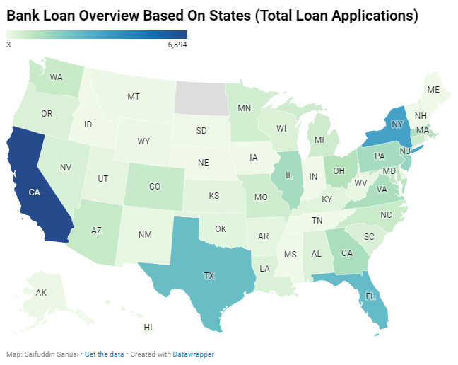
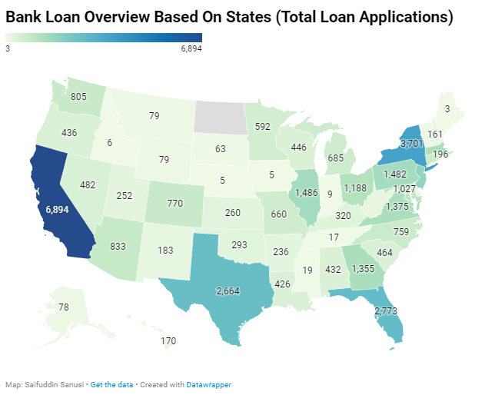
Overview (states)

Slide 14
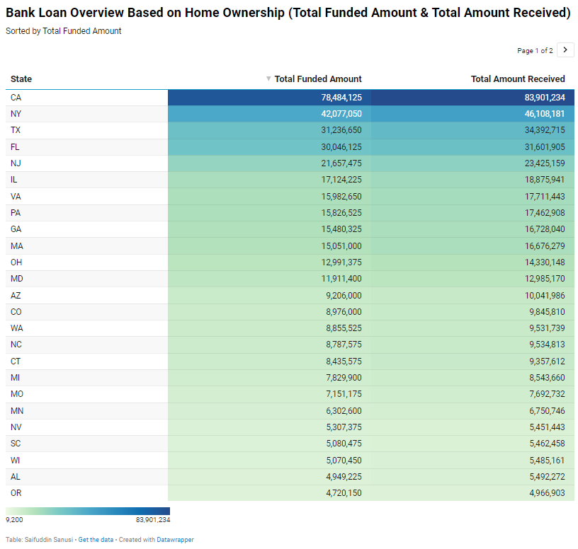
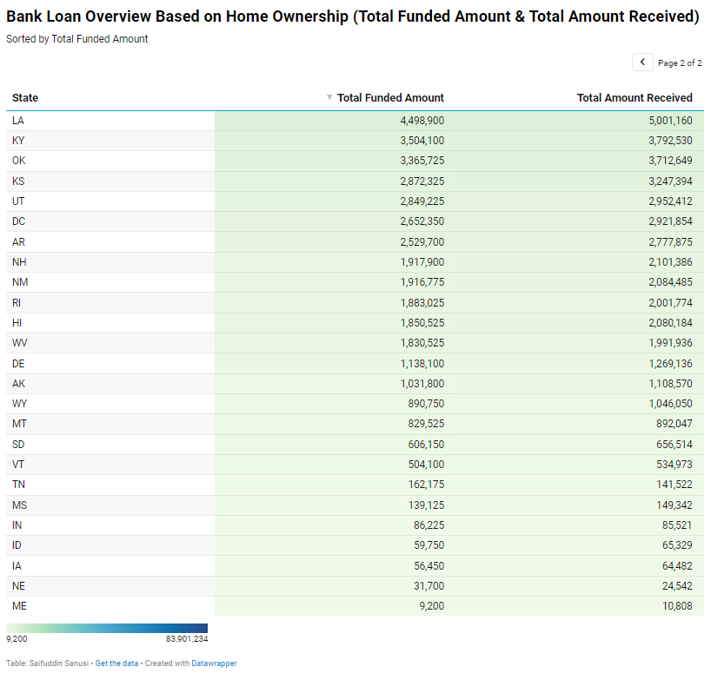
Overview (states)

Slide 15
Overview (states)
Total Funded Amount
The largest amount of loans funded also corresponds to California, which has $78.48 million in loans disbursed. Other high-funded states include New York ($42.08 million), Texas ($31.23 million), and Florida ($30.04 million).
The smallest funded amounts appear in states like Idaho (ID) with $59,750 and Iowa (IA) with $56,450.
Total Amount Received
The states that received the most funds back from borrowers are California ($83.90 million), New York ($46.1 million), Florida ($31.60 million), and Texas ($34.39 million).
The smallest amounts received come from states such as Idaho ($65,329) and Iowa ($64,482).
Conclusion & Recommendations
Geographic Concentration: The highest loan activity is concentrated in states with large populations and economic centers, such as California, New York, Texas, and Florida. These states lead in terms of both loan applications and the amounts funded and received. This suggests that the bank's lending operations are most active in the most populous states.
Low-Volume States: States like Iowa, Idaho, and Vermont show very limited loan activity, with both small numbers of applications and low funded amounts. These states may be areas where the bank could explore market expansion or decide to minimize its efforts depending on the economic potential.

Slide 16
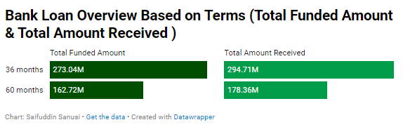
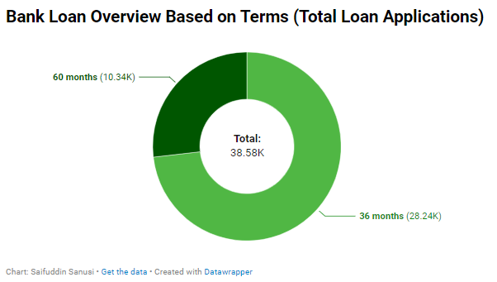
Overview (terms)
Total Funded Amount
The total funded amount for 36-month loans is significantly higher than the funded for 60-month loans.
Total Amount Received
The 36-month loans, the bank has received is higher than the for 60-month loans.
Performance by Loan Term
The total amount received for 36-month loans is about 108% of the total amount funded while 60-month loans received is 109% of the total funded.
Conclusion
Shorter-Term Loans Dominate: The 36-month loan term is more popular, accounting for almost three times as many applications as the 60-month term. These shorter loans are also associated with higher total amounts funded and received, making them a key part of the bank’s loan portfolio.

Slide 17
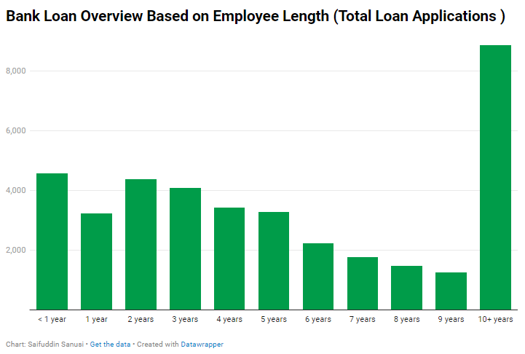
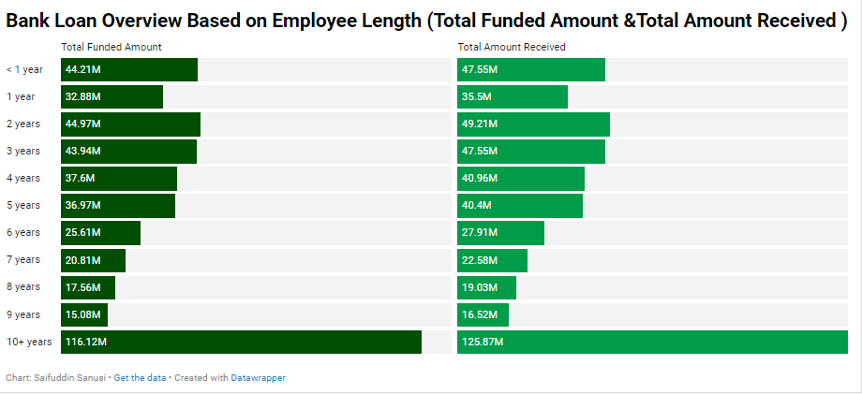
Overview (EMPLOYEE LENGTH )
Loan Application
Employees with 10+ years of experience account for the largest portion of loan applications, with 8,870 applications, representing a significant share of the total loan portfolio.
The next highest group is employees with <1 year of experience, with 4,575 applications, followed by those with 2 years of experience (4,382 applications).
Total Funded Amount
Employees with 10+ years of experience received the highest total funded amount of $116,115,950, which is almost three times more than the next largest group (employees with <1 year of experience at $44,210,625).
Funding decreases with fewer years of experience, with employees in the 6-9 year range receiving some of the lowest total amounts.

Slide 18
Overview (EMPLOYEE LENGTH )
Total Amount Received
Employees with 10+ years of experience have contributed the highest total amount received at $125,871,616, significantly higher than other groups.
All groups show solid repayment relative to the amount funded. However, employees in the 6 to 9 years segment have slightly lower total amounts received relative to what was funded.
Future Recommendations
Focus on Retaining Long-Term Clients: Offering loyalty incentives, lower interest rates, or additional financial products (e.g., investment opportunities) to the employees with 10+ years of experience.
Expand Support for Early-Career Borrowers: The bank should consider expanding its offerings to newer employees (<1 year of experience). This could include tailored loan packages that focus on first-time borrowers, lower initial loan amounts, or flexible repayment plans.
Address the Mid-Career Segment: The relatively lower loan demand from employees in the 6 to 9 years segment suggests potential untapped opportunity. The bank could explore why this group applies for fewer loans (e.g., higher perceived risks, different financial priorities) and offer tailored products to meet their needs.

Slide 19
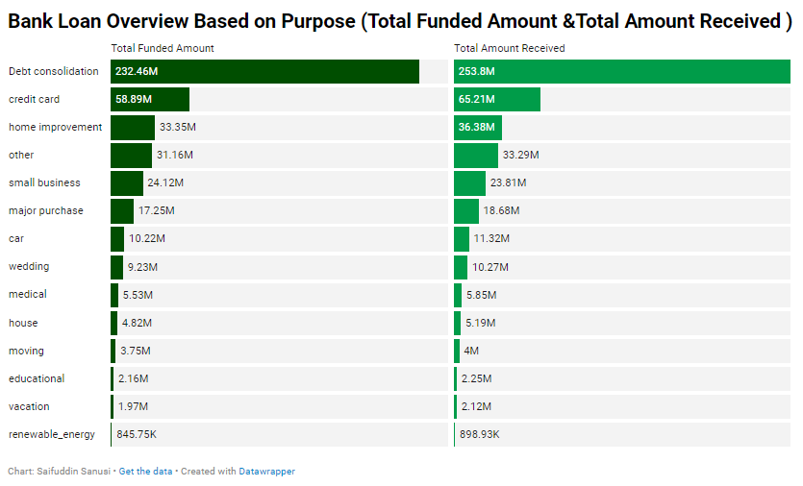
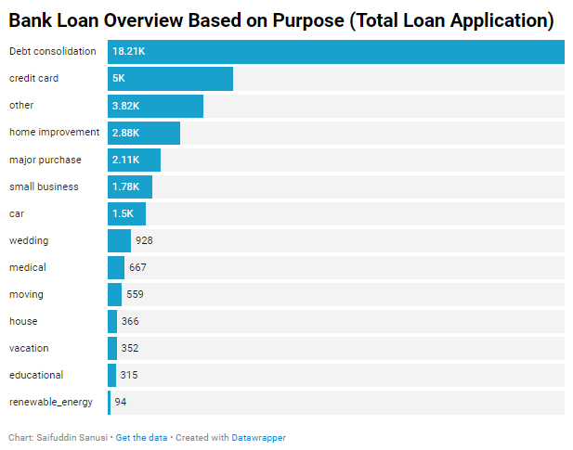
Overview (purposes)
Loan Applications
Debt consolidation dominates the loan applications with 18,214 applications, more than three times the next highest category, credit card loans (4,998 applications).
Total Funded Amount
Debt consolidation has the largest funded amount at $232,459,675, which aligns with its high number of applications. Credit card loans have the second-highest funded amount at $58,885,175, followed by home improvement loans at $33,350,775.

Slide 20
Overview (purposes)
Total Amount Received
Many loan categories exhibit strong repayment performance, with several categories receiving more than what was initially funded. For example:
Debt consolidation: Repayment rate of around 109% of the funded amount.
Credit card: Repayment rate of 110.7%.
Home improvement: Repayment rate of 109%.
Recommendations
Expand Debt Consolidation and Credit Card Loan Offerings: These categories make up the largest share of both applications and repayment, the bank should continue to invest in and promote debt consolidation and credit card loan products. Offering competitive rates and flexible repayment terms will help maintain strong demand.
Target Home Improvement Loans for Growth:The home improvement loan segment demonstrates excellent repayment and has substantial demand.

Slide 21
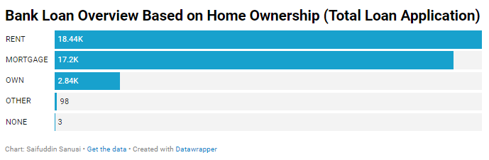
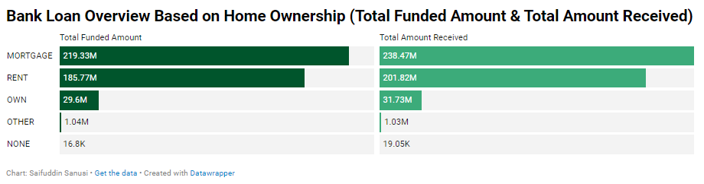
Overview (home ownership)
Loan Applications
Renters have the highest number of loan applications at 18,439, followed closely by mortgage holders with 17,198 applications.
Total Funded Amount
Mortgage holders account for the largest share of the total funded amount, with $219,329,150 funded.
Renters come second with $185,768,475 funded, which is still substantial but slightly lower than mortgage holders, despite having more applications.
Total Amount Received
Mortgage holders show the highest total repayment, with $238,474,438 received. This indicates that they are not only receiving the largest loans but also repaying a significant portion.

Slide 22
Overview (home ownership)
Future Recommendations
Focus on Mortgage Holders and Renters for Loan Growth
Given that mortgage holders and renters dominate both in volume and repayment strength, the bank should focus on enhancing loan offerings tailored to these groups.
Mortgage holders, offering additional loan products like home equity loans or refinancing options could boost loan activity further.
Renters could be targeted with tailored financial products, such as loans for home purchases, moving expenses, or even lease buyout financing, to capture more of this audience.
Leverage Strong Repayment Trends Among Homeowners
Although the volume of loans to homeowners (who own outright) is smaller, they demonstrate strong repayment rates. The bank could develop more tailored loan products for this segment, such as retirement loans, home renovation loans, or reverse mortgages for older homeowners, capitalizing on their reliable repayment history.

Slide 23
Project Limitations
Limited Data on Certain Demographics:
There is very little data on loan applications from the "none" and "other" homeownership categories. This limits the bank's understanding of potential market opportunities or challenges in these smaller segments.
Narrow Loan Terms:
The data only reflects two loan term options: 36 months and 60 months, which limits insight into customer preferences for other potential loan durations, such as shorter-term or longer-term loans (e.g., 12 months, 48 months). This gap restricts understanding of broader customer needs.
Lack of Creditworthiness Data:
The analysis does not account for credit scores, income levels, or debt-to-income ratios. This omission limits the bank's ability to understand the risk associated with different borrower groups and the likelihood of defaults.
Regional Disparities:
Some states have negligible loan activity. The bank’s market penetration appears to be uneven across regions, potentially missing growth opportunities in underrepresented states.

Slide 24
Recommendations for Future Projects:
For Bank Employees:
Enhance Customer Interaction for Mortgage Holders and Renters: Focus on offering personalized loan products, such as refinancing options, home equity loans, and tailored personal loans for renters, particularly for home improvement and debt consolidation.
Data-Driven Loan Offerings: Use the data to guide personalized loan offers. For example, customers with strong repayment histories could receive targeted offers for larger loans, lower interest rates, or refinancing options.
Gather More Customer Insights: Employees should engage in data collection and surveys to better understand why certain customer segments, like "none" and "other," have minimal engagement with the bank's loan offerings.
For Bank Management:
Geographical Targeting: Focus on regions where loan applications are low but repayment rates are high, like certain underutilized states. Marketing campaigns and outreach programs tailored to high-potential regions could increase loan applications. Regions such as California, Texas, New York, and Florida demonstrate high loan activity and repayments. Management should continue to focus on these areas, but also consider expanding to underrepresented states with good repayment rates, such as Washington, Colorado, and Massachusetts.
Product Innovation for Underrepresented Groups: Investigate opportunities in the "none" and "other" homeownership categories. Even though these segments are small, there may be a niche for unique financial products, such as shared housing loans or alternative housing financing.
Leverage Employee Tenure Data: Utilize the insights from employee length of employment to develop loan products targeting mid-career professionals. Employees with 2 to 5 years of tenure tend to be high loan applicants with strong repayment, so specialized loan products for this group, like career development loans or advanced education loans, could be attractive.
Monitor External Economic Trends: Incorporate economic indicators such as changes in interest rates, inflation, and housing market trends into future loan projects. This will help the bank to be more adaptable to market shifts and continue targeting the right customer segments.

Slide 25
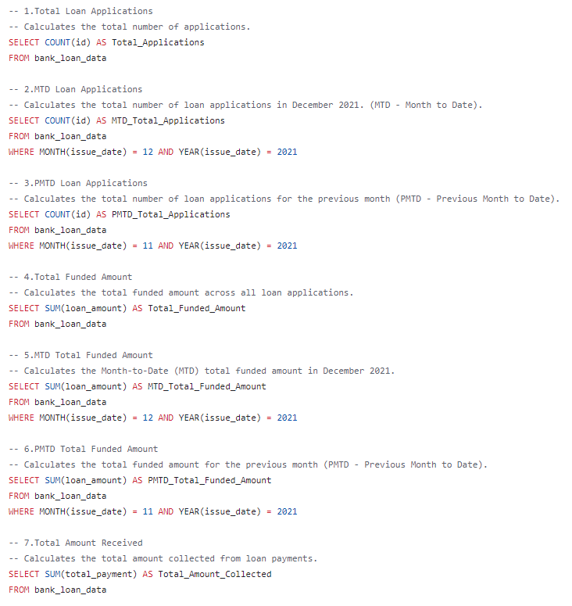
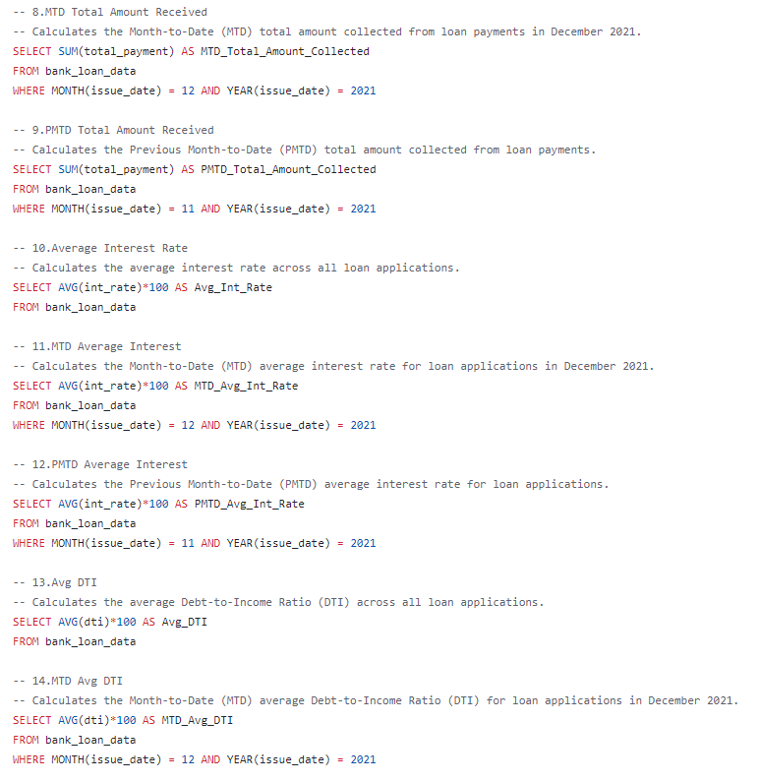

Slide 26
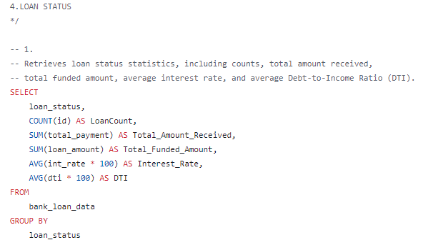
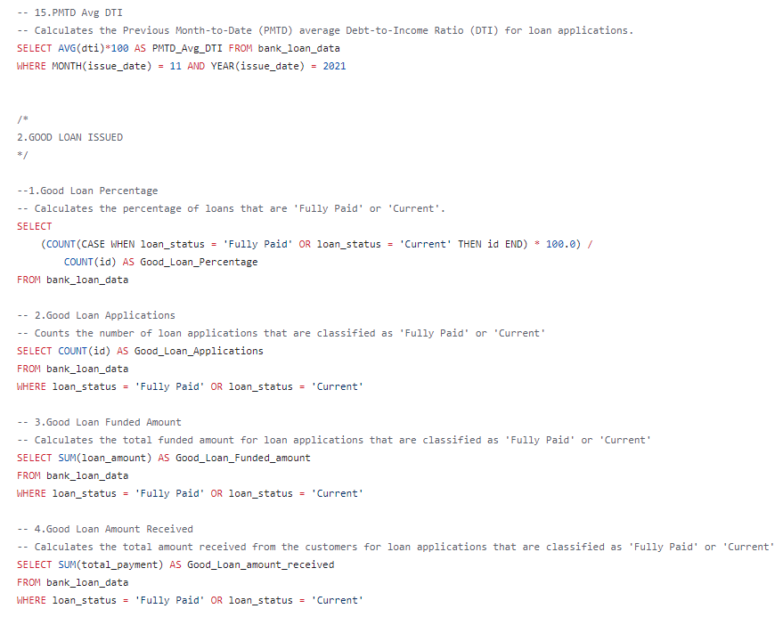
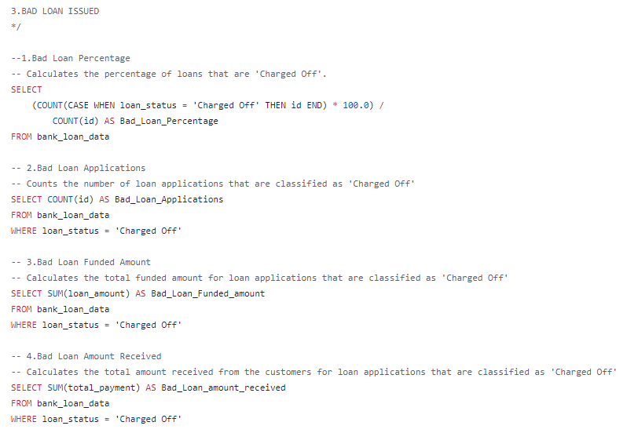
Overview (SQL CODING)

